Slide 1
Sampling and Distribution

Slide 2
1.
Probability and Random Variables

Slide 3
Probability
Example:
the probability of flipping a coin,
(a head or tail). We write P(heads) = ½ .
the number of ways of achieving success. the total number of possible outcomes.

Slide 4
Random Variable
A Random Variable is a set of possible (numeric) values from a random experiment.
Discrete – are ones that have a finite or countable number of possible outcomes.
Example: getting number 5 by rolling a dice
Continuous – are ones that have an infinite or uncountable number of possible outcomes.
Example: sum of height of all students in PUP Sta. Mesa

Slide 5
Random Variable
Example:
X = { number of “heads” after 3 flips of a fair coin};
HHH THH P(X=0) = 1/8
HHT THT P(X=1) = 3/8
HTH TTH P(X=2) = 3/8
HTT TTT P(X=3) = 1/8

Slide 6
2.
Useful Distribution

Slide 7
Useful Distribution
Discrete Distributions
Continuous Distributions

Slide 8
Types of Discrete Distributions
Uniform Distribution
All Outcomes are Equally likely “Equiprobable”.
Example: Flipping a coin Same Tail and Same head in a same time.

Slide 9
Bernoulli Distribution
Events with only two possible outcomes.
Whether one outcome is more likely occur.
Example: a student will pass or fail an exam.

Slide 10
Binomial Distribution
Carrying out a similar experiment several times in a row per iteration.
Example: We could be flipping the coin 3 times and trying to calculate the likelihood of getting heads twice(2x).

Slide 11
Poisson Distribution
To test out how unusual an event frequency is for a given interval.
Example: Imagine we know that Kobe Bryant Average 60 points per game
during regular season.

Slide 12
Useful Types of Continuous Distributions
Logistic Distribution
Useful in forecast analysis
Useful for determining a cut-off point for a successful outcome.

Slide 13
Normal Distribution
The normal distribution is a probability function that describes how the values of a variable are distributed.

Slide 14
3.
Expected Values

Slide 15
Expected Value
The Expected Value (EV) is an anticipated value for an investment at some point in the future. In Statistics and probability analysis, the expected value is calculated by multiplying each of the possible outcomes by the likelihood each outcome will occur and then summing all of those values, Investors can choose the scenario most likely to give desired outcome.

Slide 16

Expected Value
To calculate the EV for a single discrete random variable, you must multiply the value of the variable by the probability of that value occurring.

Slide 17
Expected Value
For example, a normal six-sided die. Once you roll the die, it has an equal one-sixth chance of landing on one, two, three, four, five or six. Given this information, the calculation is straightforward.
EV = 1 * 1/6 + 2 * 1/6 + 3 * 1/6 + 4 * 1/6 + 5 * 1/6 + 6 * 1/6 = 1/6 + 2/6 + 3/6 + 4/6 + 5/6 + 6/6 = 21/6 or 3.5
Xi | 1 | 2 | 3 | 4 | 5 | 6
P(Xi) | 1/6 | 1/6 | 1/6 | 1/6 | 1/6 | 1/6

Slide 18
4.
Random Sampling
Bryn Espiritu

Slide 19
Random Sampling
Random sampling is a way of selecting a sample of observations from a population in order to make inferences about the population.
Random sampling is also known as probability sampling.
The main forms of random sampling are simple random sampling, stratified sampling, cluster sampling, and multistage sampling. Samples that are not random are typically called convenience samples.

Slide 20
Random Sampling
Let’s Go Deeper!!
Simple random sampling is the most straightforward approach for getting a random sample. It involves picking a desired sample size and selecting observations from a population in such a way that each observation has an equal chance of selection until the desired sample size is achieved
For example, exit polls from voters that aim to predict the likely results of an election. Random sampling is also known as probability sampling

Slide 21
Types of Random Sampling
The key aspect of random sampling lays in its name. The selection of observations must occur in a 'random' way, meaning that they do not differ in any significant way from observations not sampled. It is typically assumed that statistical tests contain data that has been obtained through random sampling.
Simple random sampling
Stratified random sampling
Cluster sampling
Multistage sampling

Slide 22

Types of Random Sampling
A random sample may include choosing the names of 25 employees out of a hat in a company of 250 employees. The population is all 250 employees, and the sample is random because each employee has an equal chance of being chosen.

Slide 23
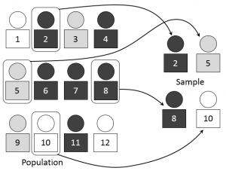
Types of Random Sampling
Simple Random Sampling;
N =Population, n = Sample, bowl = Roulette;
N = 12 & n = 4;
Imagine the people illustrated in the image in the left are game pieces. Place the 12 game pieces in a bowl and (again, without looking) choose 4. This is simple random sampling.

Slide 24
Perform it quickie and safe
A larger population might be “All people who have had nCoV in the China.” That list of participants would be extremely hard to obtain. Where would you get such a list in the first place? You could contact individual hospitals (of which there are hundreds or thousands…) and ask for a list of patients (would they even supply you with that information? If you could somehow obtain this list then you will end up with a list of 50,000 people which you then have to put into a “bowl” of some sort and choose random people for your sample. This type of situation is the type of real-life situation you’ll come across and is what makes getting a simple random sample so hard to undertake.

Slide 25
Instruct me…
Sample question: Outline the steps for obtaining a simple random sample for outcomes of strokes in China hospitals with nCoV Cases.

Slide 26
Steps
Step 1: Make a list of all the hospitals in China with nCoV cases (there are several hundred: certain Dept. keep records of medical cases with huge intel).
Step 2: Assign a sequential number to each nCoV treatment facility (1,2,3…n). This is your sampling frame (the list from which you draw your simple random sample).
Step 3: Figure out what your sample size is going to be. Sample Size is Current Example of Records use to other SRS cases
Step 4: Use a random number generator to select the sample, using your sampling frame (population size) from Step 2 and your sample size from Step 3. For example, if your sample size is 50 and your population is 500, generate 50 random numbers between 1 and 500.
.

Slide 27
5.
Sampling Distribution

Slide 28
Sampling Distribution
Sampling
the method of gathering information about a population by taking a representative of the population called sample
Sampling Distribution
Sampling Distribution a sampling distribution is the probability distribution of a given random-sample-based statistic.

Slide 29
Sampling Distribution
Can the data gathered from the sample be used to make inferences about the population?
Statistically speaking, yes. However, every sample has a different statistic. And this statistic is also considered a random variable because the data vary from one sample to another.

Slide 30
Sampling Methods
Simple Random Sampling
Systematic Random Sampling
Stratified Sampling
Cluster Sampling

Slide 31

Sampling Methods
Simple Random Sampling
involves selecting a sample size n from a population of size N so that all elements of the population have equal chances of being part of the sample.

Slide 32
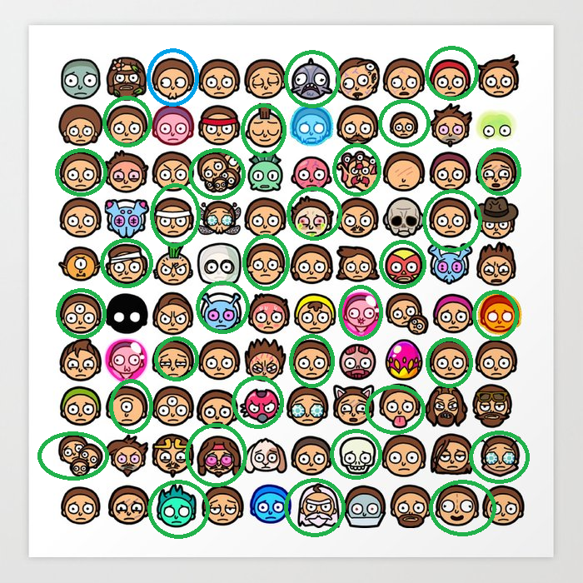
Sampling Methods
Systematic Random Sampling
involves using a random start to determine the first element of the sample and the selection of the rest of the sample is done systematically
Random Start and Interval

Slide 33
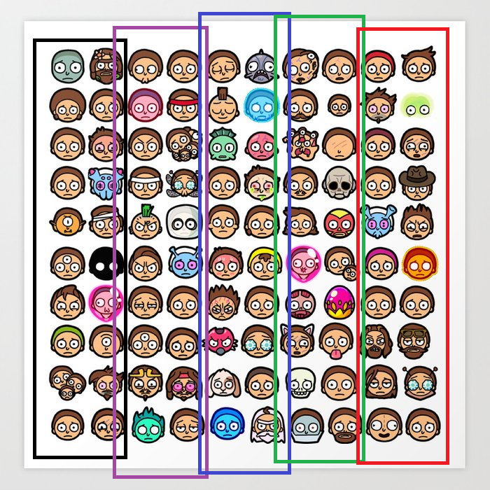
Sampling Methods
Cluster Sampling
the elements of the population are divided into groups called CLUSTERS. Clusters are naturally occurring like barangays, cities, or municipalities. Samples are obtained from each cluster by SRS.

Slide 34
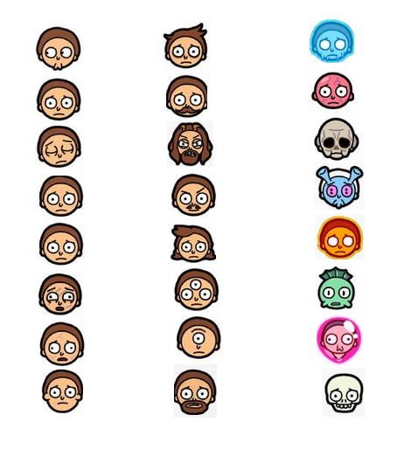
Sampling Methods
Strata 1
Strata 2
Strata 3
Stratified Sampling
involves dividing the population into groups called STRATA according to some chosen classification category such as age, gender, geographic location, and so on. Subsample from each stratum are selected by simple random sampling.

Slide 35

THANK YOU!

